Slide 1
EXCEL_ASSESMENT 1
4382_POOVISHA SABAPATHI

Slide 2
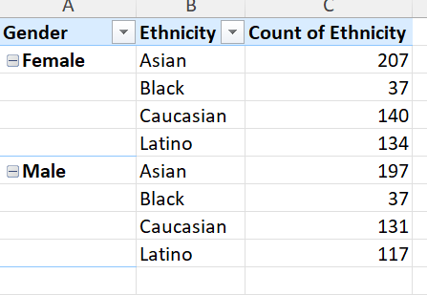
Q1 The summary of gender based on ethnicity is shown below.

Slide 3
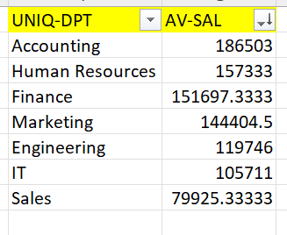
Q3 Avg salaries between different departments. There is a significant difference between Accounting and Sales department.

Slide 4
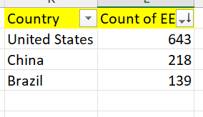
Q4 Highest number of employees is present in united states.

Slide 5
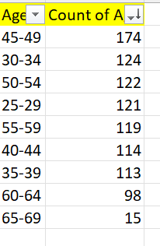
Q5 Common age range between employees is present between 45-49.

Slide 6
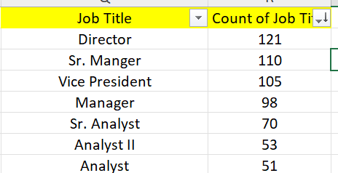
Q7 the most frequently occurred job title is director

Slide 7
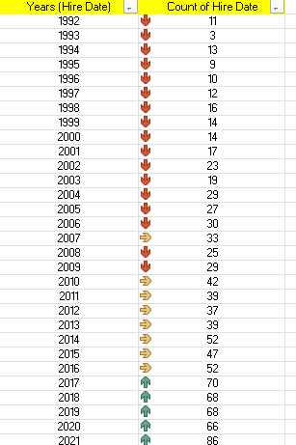
Q10 from year 1992-2009, there is decrease in hire date. From 2017 to 2021 there is increase in hire date.

Slide 8
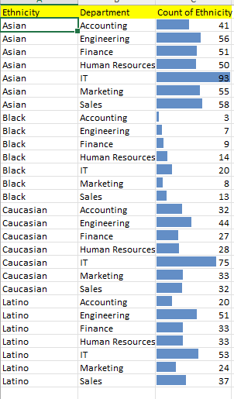
Q9 there are some departments where there is significant difference in terms of ethnicity. IT and Accounting.

Slide 9
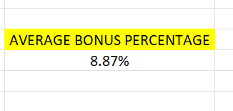
Q6 Average bonus percentage is 8.87%

